Slide 1


Balanced scorecard slide 1
AIR Travel Safety
Airline Safety Analysis: ABC Airlines
Anirban Pal

Slide 2
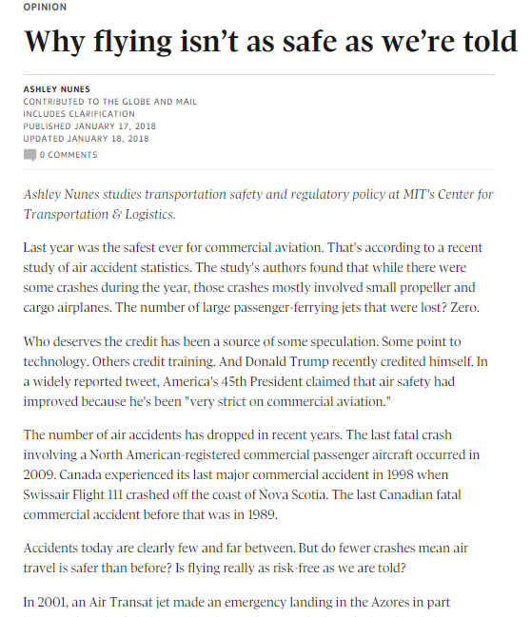
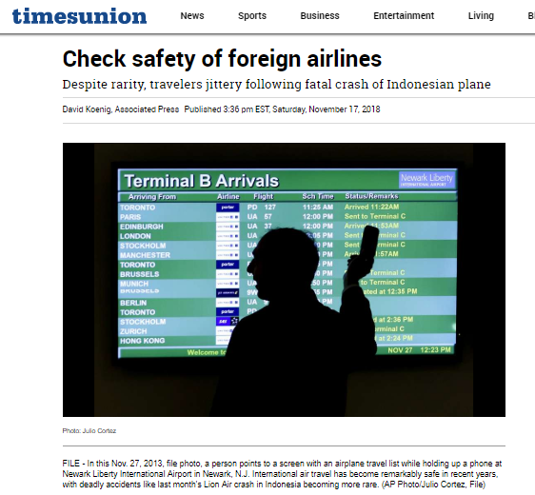
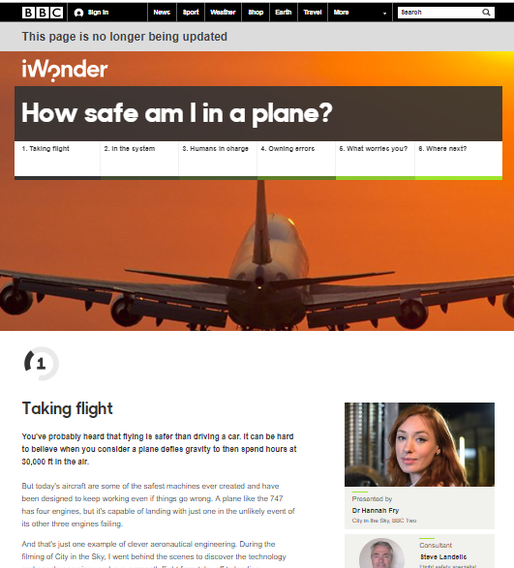
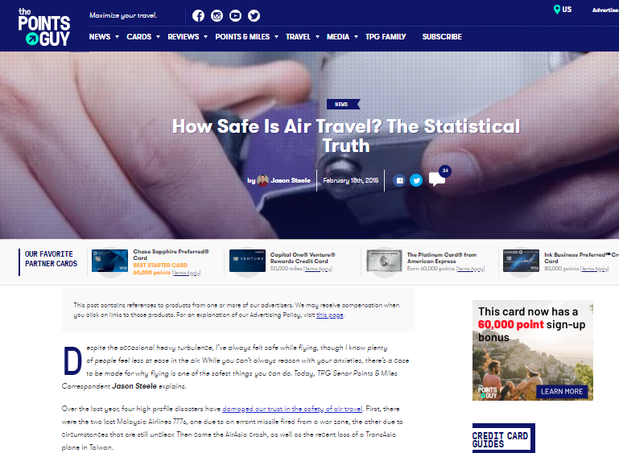
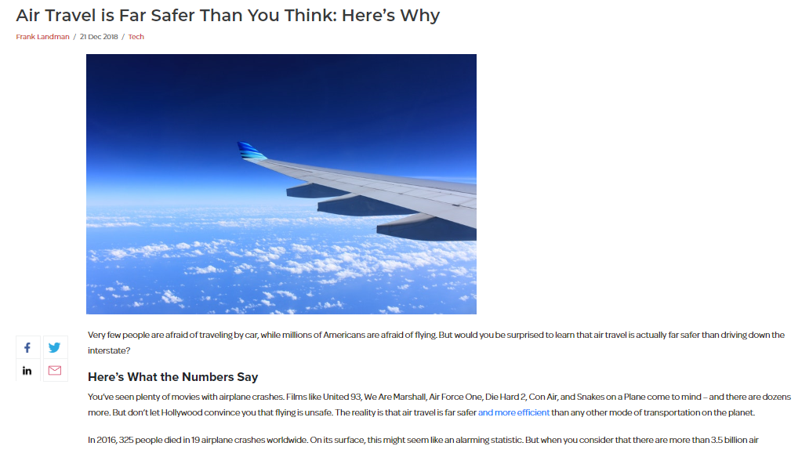
Balanced scorecard slide 2
What people say

Slide 3
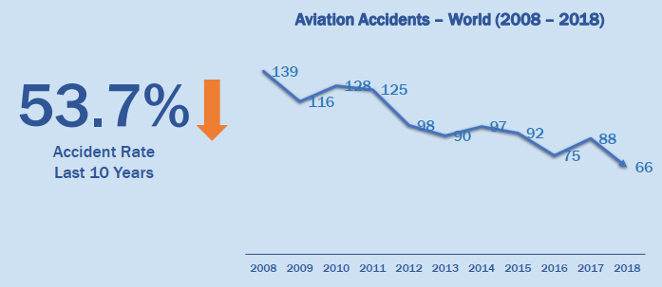
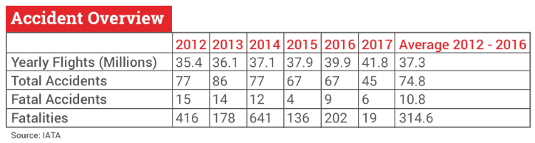
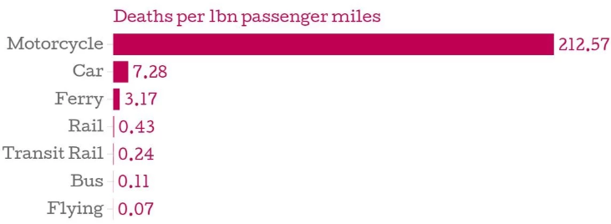
Balanced scorecard slide 4
Statistically Safe

Slide 4
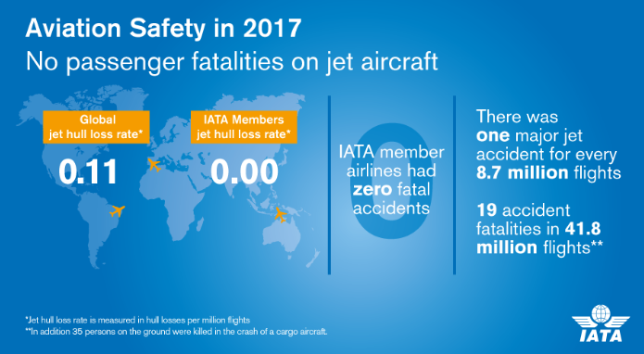

Balanced scorecard slide 3
Why ABC Airlines is one of the safest

Slide 5
Balanced scorecard slide 10
THANK YOU

